Slide 1
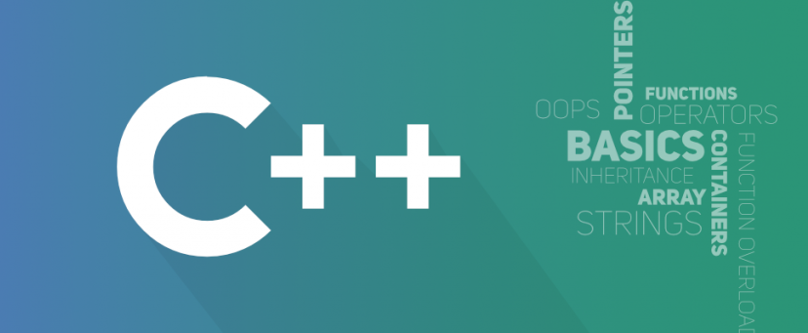
Object Oriented Programming
António J. R. Neves
DETI/UA
Sessão 8

Slide 2
Contents
exceptions
enumerations
unions
variant
optional
any
string_view
pairs and tuples
smart pointers
casts

Slide 3
Some links
compilation process
Make tutorial
CMake tutorial or Clion CMake tutorial
Meson
create libraries in C/C++
GNU debugger
debug and profiling
ninja build system

Slide 4
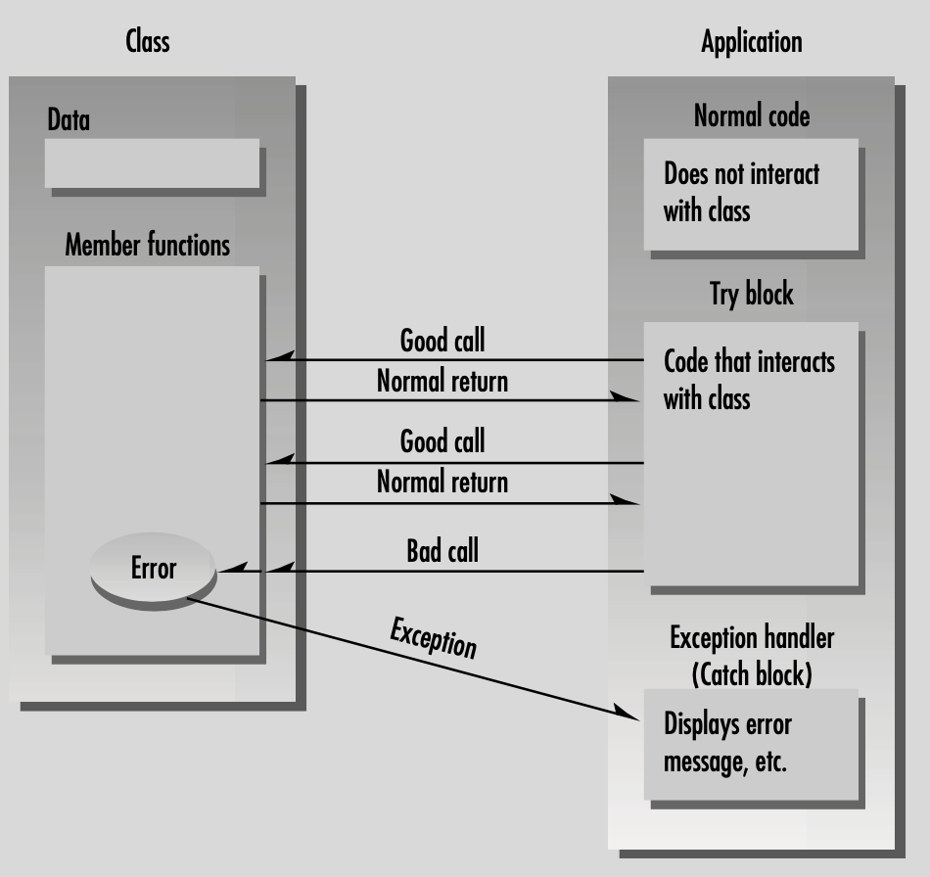
Exceptions
Exceptions provide a convenient, uniform way to handle errors that occur in runtime within classes
They are caused by a wide variety of exceptional circumstance, such as running out of memory, not being able to open a file, trying to initialize an object to an impossible value, or using an out-of-bounds index to a vector
The exception mechanism uses three new C++ keywords: throw, catch, and try

Slide 5
Exceptions
Ordinarily the application’s calls to the class member functions cause no problems - sometimes, however, the application makes a mistake, causing an error to be detected in a member function
This member function then informs the application that an error has occurred - when exceptions are used, this is called throwing an exception
In the application we install a separate section of code to handle the error - this code is called an exception handler or catch block; it catches the exceptions thrown by the member function
Any code in the application that uses objects of the class is enclosed in a try block. Errors generated in the try block will be caught in the catch block

Slide 6
Example
template <class T> void Stack<T>::pop () { if (elems.empty()) { throw out_of_range("Empty stack"); } // remove last element elems.pop_back(); } template <class T> T Stack<T>::top () const { if (elems.empty()) { throw out_of_range("Empty stack"); } // return copy of last element return elems.back(); } | int main() { try { // manipulate int stack s1.push(10); s1.push(20); cout << "top: " << s1.top() <<endl; s1.pop(); cout << "top: " << s1.top() <<endl; // manipulate string stack s2.push("hello"); s2.push("ppo"); cout << "top: " << s2.top() <<endl; s2.pop(); cout << "top: " << s2.top() <<endl; s2.pop(); cout << "top: " << s2.top() <<endl; } catch (exception& e) { cerr << "Exception: " << e.what() << endl; return -1; } }
What is printed in the terminal?

Slide 7
Example
Sequence of Events:
1. Code is executing normally outside a try block.
2. Control enters the try block.
3. A statement in the try block causes an error in a member function.
4. The member function throws an exception.
5. Control transfers to the exception handler (catch block) following the try block.
Any of the statements in the try block could cause an exception, but we don’t need to worry about checking a return value for each one, because the try-throw-catch arrangement handles them all automatically
When an exception is thrown, a destructor is called automatically for any object that was created by the code up to that point in the try block

Slide 8
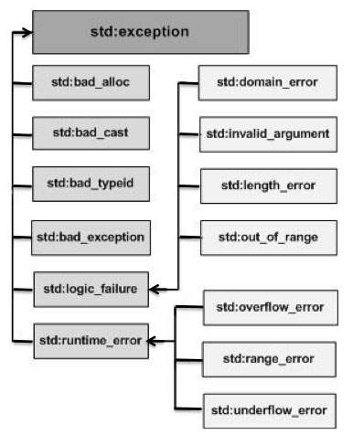
C++ Standard Exceptions
C++ provides a list of standard exceptions defined in <exception> which we can use in our programs - these are arranged in a parent-child class hierarchy
You can define your own exceptions by inheriting and overriding exception class functionality
class MyException : public exception {
public:
const char* what() const throw () {
return "C++ Exception";
}
};
what() is a public method provided by exception class and it has been overridden by all the child exception classes - this returns the cause of an exception

Slide 9
Exceptions in modern C++
Exceptions are preferred in modern C++ for the following reasons:
An exception forces the calling of code to recognize an error condition and handle it - unhandled exceptions stop program execution
An exception jumps to the point in the call stack that can handle the error - intermediate functions can let the exception propagate
The exception stack-unwinding mechanism destroys all objects in scope after an exception is thrown, according to well-defined rules
An exception enables a clean separation between the code that detects the error and the code that handles the error

Slide 10
Exceptions - guidelines
Use asserts to check for errors that should never occur
Use exceptions to check for errors that might occur, for example, errors in input validation on parameters of public functions
Use exceptions when the code that handles the error is separated from the code that detects the error by one or more intervening function calls
Consider whether to use error codes instead in performance-critical loops, when code that handles the error is tightly coupled to the code that detects it
For every function that might throw or propagate an exception, provide one of the three exception guarantees: the strong guarantee, the basic guarantee, or the nothrow guarantee
Throw exceptions by value, catch them by reference - don't catch what you can't handle
Use standard library exception types when they apply - derive custom exception types from the exception Class hierarchy

Slide 11
Some more links
https://learn.microsoft.com/en-us/cpp/cpp/templates-cpp?view=msvc-170
https://learn.microsoft.com/en-us/cpp/cpp/exception-handling-in-visual-cpp?view=msvc-170
https://en.cppreference.com/w/cpp/language/templates
https://en.cppreference.com/w/cpp/language/exceptions

Slide 12
Enumerations
An enumeration is a user-defined data type that consists of integral constants. To define an enumeration, keyword enum is used
enum season { spring, summer, autumn, winter };
By default, spring is 0, summer is 1 and so on. You can change the default value of an enum element during declaration (if necessary)
enum season
{ spring = 0,
summer = 4,
autumn = 8,
winter = 12
};
Subsequent enumerators, if they are not given an explicit value, receive the value of the previous enumerator plus one.

Slide 13
Enumerator scope
In the original C and C++ enum types, the unqualified enumerators are visible throughout the scope in which the enum is declared
In scoped enums, the enumerator name must be qualified by the enum type name
enum season {spring, summer, autumn, winter};
enum class weekDays {Sunday = 1, Monday, ...};
int main() {
enum season s;
enum weekDays wd;
s = spring;
wd = weekDays::Monday;
return 0;
}

Slide 14
Casting rules
Unscoped enum constants can be implicitly converted to int, but an int is never implicitly convertible to an enum value
A cast is required to convert an int to a scoped or unscoped enumerator. However, you can promote a unscoped enumerator to an integer value without a cast
Scoped enumerators must be qualified by the enum type name (identifier) and cannot be implicitly converted
class myClass{
public:
enum cenas {black, white};
enum class cenas2 {red, blue};
…
}
int main(){
enum myClass::cenas c;
c = myClass::white;
cout << c << endl;
enum myClass::cenas2 c2;
c2 = myClass::cenas2::blue;
cout << static_cast<int>(c2) << endl;
}

Slide 15
unions
A union is a user-defined type in which all members share the same memory location
This definition means that at any given time, a union can contain no more than one object from its list of members
It also means that no matter how many members a union has, it always uses only enough memory to store the largest member
A union can be useful for conserving memory when you have lots of objects and limited memory
However, a union requires extra care to use correctly: you're responsible for ensuring that you always access the same member you assigned
Before use a union, consider whether the problem you're trying to solve could be better expressed by using a base class and derived class types
Take a look at union-like classes: it encloses the union in a struct, and includes an enum member that indicates the member type currently stored in the union 🤔 - can implement tagged unions

Slide 16
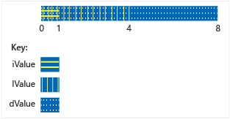
unions
union RecordType{
char c;
int i;
double d;
};
int main() {
RecordType r;
r.c = 'a';
cout << r.c << endl;
cout << r.d << endl; // undefined
r.i = 5000;
cout << r.i << endl;
cout << r.d << endl; // undefined
r.d = 5.5;
cout << r.d << endl;
cout << r.c << endl; // undefined
return 0;
}

Slide 17
Anonymous union
An anonymous union is one declared without a class-name
Names declared in an anonymous union are used directly, like nonmember variables - it implies that the names declared in an anonymous union must be unique in the surrounding scope
enum class WeatherDataType{
Temperature, Wind
};
struct Input
{
WeatherDataType type;
union
{
int temp;
double wind;
};
};
Input first;
first.type = WeatherDataType::Temperature;
first.temp = 25;
Input second;
second.type = WeatherDataType::Wind;
second.wind = 5.5;

Slide 18
union-like classes
struct S{
enum{CHAR, INT, DOUBLE} tag;
union{
char c;
int i;
double d;
};
};
void print_s(const S& s){
switch(s.tag)
{
case S::CHAR: std::cout << s.c << '\n'; break;
case S::INT: std::cout << s.i << '\n'; break;
case S::DOUBLE: std::cout << s.d << '\n'; break;
}
}
int main()
{
S s = {S::CHAR, 'a'};
print_s(s);
s.tag = S::INT;
s.i = 123;
print_s(s);
}

Slide 19
variant
The class template variant represents a type-safe union
An instance of variant at any given time either holds a value of one of its alternative types
A variant is not permitted to hold references, arrays, or the type void
A default-constructed variant holds a value of its first alternative
std::variant<int, double> v;
v = 10;
cout << get<int>(v) << endl;
v = 5.5;
cout << get<double>(v) << endl;

Slide 20
optional
"It is recommended to use optional<T> in situations where there is exactly one, clear (to all parties) reason for having no value of type T, and where the lack of value is as natural as having any regular value of T"
The class template std::optional manages an optional contained value, i.e. a value that may or may not be present - it is a wrapper for a type and a flag that indicates if the value is initialized or not
std::optional<std::string> FindUserNick(const string &s)
{
map<string, string> cenas {{"ABC", "aaabbbccc"}, {"CBD", "cccbbbddd"}};
if (cenas.count(s))
return {cenas[s]};
return {}; // same as std::nullopt;
}
...
std::optional<std::string> nick = FindUserNick("ABC");
if (nick) // nick.has_value()
cout << nick.value() << endl;

Slide 21
any
provides a type-safe container to store single value of any type
we must use any_cast<type>(any_var) to convert any_var value into its original type
if a stored value has a type other than the one trying to cast to, then a bad_any_cast exception will be thrown by the compiler
any can be constructed in three different ways using Copy Initialization, Parameterized constructor and assignment operator
// any type
std::any a = 1;
std::cout << a.type().name() << ": " << std::any_cast<int>(a) << '\n';
// bad cast
try{
a = 1;
std::cout << std::any_cast<float>(a) << '\n';
}
catch (const std::bad_any_cast& e)
{
std::cout << e.what() << '\n';
}
a = 1;
if (a.has_value())
...
a = 1;
int* i = std::any_cast<int>(&a);
std::cout << *i << "\n";

Slide 22
string_view
unlike string, which keeps its own copy of the string, string_view provides a view of a string that is defined elsewhere
string_view is not only fast, but has many of the functions that we know from string
if we change the viewed string, the changes are reflected in the string_view
Best practice
Use string_view instead of C-style strings.
Prefer string_view over string for read-only strings, unless you already have a string
make sure that the underlying string viewed with a string_view does not go out of scope and isn’t modified while using the string_view
To convert a string_view to a C-style string, we can do so by first converting to a string and then use the method c_str()

Slide 23
string_view
std::string_view text{ "hello" }; // view the text "hello", stored in the binary
std::string_view str{ text }; // view of the same "hello"
std::string_view more{ str }; // view of the same "hello"
std::cout << text << ' ' << str << ' ' << more << '\n';
str = "Trains are fast!";
std::cout << str.length() << '\n'; // 16
std::cout << str.substr(0, str.find(' ')) << '\n'; // Trains
std::cout << (str == "Trains are fast!") << '\n'; // 1
std::cout << str << '\n'; // Trains are fast!
std::string_view sv{ "balloon" };
// Create a std::string from the std::string_view
std::string s3{ sv };
// Get the null-terminated C-style string.
auto szNullTerminated{ s3.c_str() };
// Pass the null-terminated string to the function that we want to use.
std::cout << s3 << " has " << std::strlen(szNullTerminated) << " letter(s)\n";

Slide 24
pairs and tuples
A tuple is an object capable to hold a collection of elements where each element can be of a different type
Pair is a class that couples together a pair of values, which may be of different types
tuple<int, int, char> foo(int n1, int n2) { // Packing values to return a tuple return make_tuple(n2, n1, 'a'); } pair<int, int> foo1(int num1, int num2) { // Packing two values to return a pair return make_pair(num2, num1); } | int a,b; char cc; // Unpack the elements returned by foo tie(a, b, cc) = foo(5, 10); // Storing returned values in a pair pair<int, int> p = foo1(5,2); cout << "Values returned by tuple: "; cout << a << " " << b << " " << cc << endl; cout << "Values returned by Pair: "; cout << p.first << " " << p.second;

Slide 25
smart pointers
The Standard Library includes smart pointers, which are used to help ensure that programs are free of memory and resource leaks and are exception-safe
In modern C++, raw pointers are only used in small code blocks of limited scope, loops, or helper functions where performance is critical and there is no chance of confusion about ownership
A smart pointer is a class template that you declare on the stack, and initialize by using a raw pointer that points to a heap-allocated object
After the smart pointer is initialized, it owns the raw pointer - this means that the smart pointer is responsible for deleting the memory that the raw pointer specifies
The smart pointer destructor contains the call to delete, and because the smart pointer is declared on the stack, its destructor is invoked when the smart pointer goes out of scope
Access the encapsulated pointer by using the familiar pointer operators, -> and *, which the smart pointer class overloads to return the encapsulated raw pointer

Slide 26
Example
class MyClass{
private:
int a;
double b;
public:
MyClass(int _a, double _b) : a(_a), b(_b) {}
~MyClass(){
cout << "destructor" << endl;
}
void print(){
cout << a << ";" << b << endl;
}
};
void ptrs(){
MyClass *p = new MyClass(1, 5.5);
p->print();
unique_ptr<MyClass> up(new MyClass(2, 10.5));
up->print();
}

Slide 27
smart pointers
The previous example demonstrates the following essential steps for using smart pointers
Declare the smart pointer as an automatic (local) variable (Do not use the new or malloc expression on the smart pointer itself)
In the type parameter, specify the pointed-to type of the encapsulated pointer
Pass a raw pointer to a new-ed object in the smart pointer constructor
Use the overloaded -> and * operators to access the object
Let the smart pointer delete the object
Smart pointers are designed to be as efficient as possible both in terms of memory and performance
The reset member function releases ownership of the pointer - this is useful when you want to free the memory owned by the smart pointer before the smart pointer goes out of scope (see also get())

Slide 28
types of smart pointers
unique_ptr - as the name implies, make sure that only exactly one copy of an object exists
shared_ptr - the shared_pointer is a reference counting smart pointer that can be used to store and pass a reference beyond the scope of a function
class Foo {
public:
void doSomething();
};
class Bar{
private:
std::shared_ptr<Foo> pFoo;
public:
Bar(){
pFoo = std::shared_ptr<Foo>(new Foo());
}
std::shared_ptr<Foo> getFoo(){
return pFoo;
}
};
weak_ptr - Special-case smart pointer for use in conjunction with shared_ptr - it provides access to an object that is owned by one or more shared_ptr instances, but does not participate in reference counting

Slide 29
C++ Casting Operators
A cast is a special operator that forces one data type to be converted into another:
const_cast - it is used to explicitly override - cast away (remove) - constness or volatility
static_cast - converts between types using a combination of implicit and user-defined conversions
dynamic_cast - safely converts pointers and references - if the cast fails and new-type is a pointer type, it returns a null pointer; if is a reference type, it throws an exception std::bad_cast
reinterpret_cast - converts between types by reinterpreting the underlying bit pattern

Slide 30
const_cast
class MyC { private: int i; public: MyC(): i(3) {} void f(int v) const { // this->i = v; const_cast<MyC*>(this)->i = v; } int getI() const{ return MyC::i; } }; | int i = 3; // i is not declared const std::cout << "i = " << i << endl; const int& rci = i; const_cast<int&>(rci) = 4; // OK std::cout << "i = " << i << '\n'; MyC t; std::cout << "MyC::i = " << t.getI(); t.f(4); std::cout << "MyC::i = " << t.getI();

Slide 31
dynamic_cast
struct Base { virtual ~Base() {} }; struct Derived: Base { void name() { cout << "D" << endl; } }; struct DerivedDerived: Derived { void myName() { cout << "MC" << endl; } }; | Base* b1 = new Base; if(Derived* d = dynamic_cast<Derived*>(b1)) // fail ... Base* b2 = new Derived; if(Derived* d = dynamic_cast<Derived*>(b2)){ std::cout << "downcast from b2 to d successful\n"; d->name(); // safe to call } Derived d; Base &bb = d; DerivedDerived m; try{ dynamic_cast<Derived&>(d).name(); ... try{ dynamic_cast<DerivedDerived&>(d).myName(); }catch (bad_cast e){ cout << "ERROR: " << e.what() << endl; } try{ dynamic_cast<Derived&>(m).name(); …

Slide 32
reinterpret_cast
vector<int> v = {1, 2, 3, 4, 5};
ofstream ofs("x.bin");
int n = static_cast<int>(v.size());
ofs.write(reinterpret_cast<char *>(&n), sizeof(int));
ofs.write(reinterpret_cast<char *>(v.data()), v.size() * sizeof(int));
n = 0;
ofs.close();
ifstream ifs("x.bin");
ifs.read(reinterpret_cast<char*>(&n), sizeof(int));
cout << n << endl;
vector<int> vv(n);
ifs.read(reinterpret_cast<char*>(vv.data()), vv.size() * sizeof(int));
ifs.close();
for(auto i : vv)
cout << i << " ; ";

